Slide 1


SMART INDIA HACKATHON 2025
Problem Statement ID – SIH25002
Problem Statement - Smart Tourist Safety Monitoring &
Incident Response System using Al, Geo-Fencing, and
Blockchain-based Digital ID
Theme-Travel & Tourism
PS Category- Software/Hardware
Team ID-
Team Name (Registered on portal)- Cognita

Slide 2
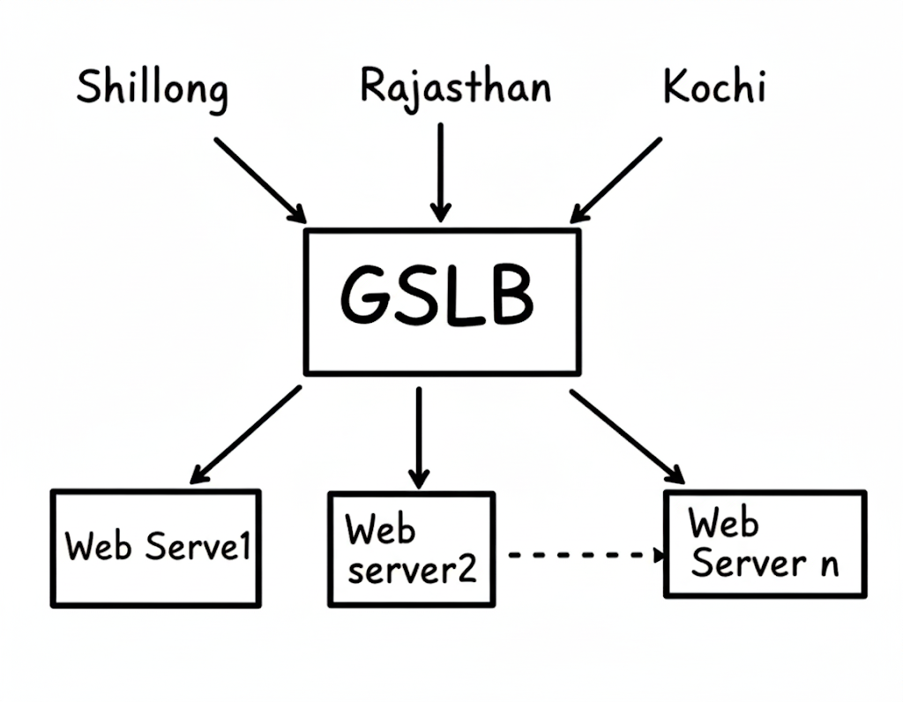
IDEA TITLE
Cognita
Solution
Security Scans: Identify and fix exposed services.
Asset Mapping: Prioritize system updates.
Ethical Hacking: Lawfully test and improve defenses.
Public Data Analysis: Find threats and exposed data securely.
Addressing the Problem
Prevent Risks: Uncover system weaknesses and data exposure.
Secure Data: Fix misconfigurations to stop leaks.
Enable Response: Provide key info to agencies for fast action.
Innovation
Hybrid Approach: Combines ethical scanning with public data analysis.
Privacy-First: Strictly follows all legal and ethical rules.
Unique Tech Stack: Integrates AI, blockchain, and mesh networking.

Slide 3
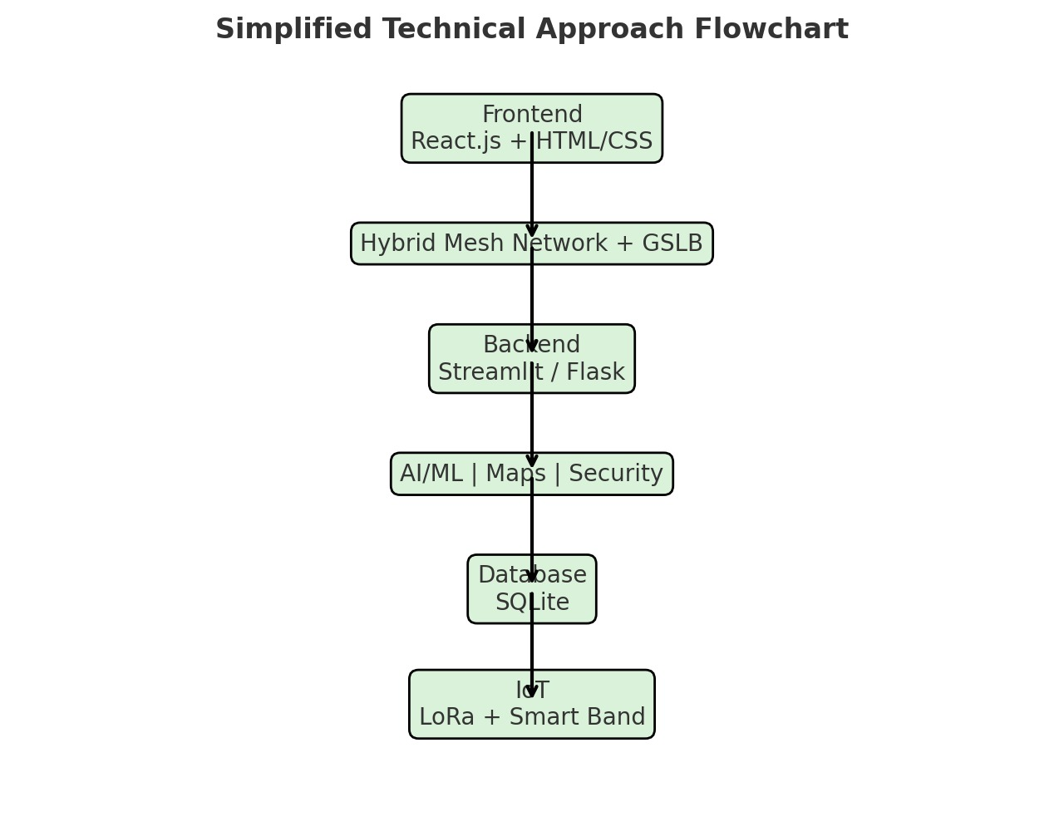
TECHNICAL APPROACH
Cognita
IoT: LoRa modules, Smart Bands
Networking: Hybrid Mesh Network, GSLB (Global Server Load Balancing)
AI/ML: NumPy, Pandas, RISK Scorer, Behaviour Anomaly, Prediction Batch
Maps & Geo-Fencing: PyDeck
Security: Ethereum Blockchain
Database: SQLite
Backend: Streamlit / Flask
Frontend: React.js, HTML/CSS

Slide 4

FEASIBILITY AND VIABILITY
cognita
Feasibility:
Achievable using low-energy sensors, GPS technology, and blockchain-supported digital identification incorporated into a wearable
device for immediate monitoring and notifications.
Challenges:
Difficult to maintain battery life, connectivity, and security when
many users rely on the watch at the same time.
Strategies:
Utilize energy-efficient design, intelligent data sharing, and robust security updates to ensure the watch remains dependable for every user.

Slide 5
IMPACT AND BENEFITS
Cognita
Potential Impact on Target Audience
Tourists and families get real-time alerts, SOS support, and peace of mind, while authorities can respond faster to emergencies.
Mesh networks ensure strong connectivity and quicker assistance, even in remote or crowded areas.
Benefits of the Solution
Social: Enhanced safety, reduced crime, peace of mind.
Economic: Boosts tourism confidence and local economy.
Environmental: Optimized resource use with AI-driven monitoring and fewer unnecessary patrols.
Technological: Encourages adoption of smart, secure digital infrastructure.

Slide 6
RESEARCH AND REFERENCES
1. Peng, Lei & Chen, Yan. (2021). Tourism safety monitoring information service system based on internet of things and block-chain. Journal of Intelligent & Fuzzy Systems. 1-7. 10.3233/JIFS-219101.
2. Cilfone et al. (2019): For an IoT-focused perspective, "Wireless Mesh Networking: An IoT-Oriented Perspective Survey on Relevant Technologies" is a valuable citation.
3. Cilfone, A.; Davoli, L.; Belli, L.; Ferrari, G. Wireless Mesh Networking: An IoT-Oriented Perspective Survey on Relevant Technologies. Future Internet 2019, 11, 99. https://doi.org/10.3390/fi11040099
Cognita

